Slide 1



Slide 2



01CE1301 – Data Structure
Unit - 3
Non-Linear Data Structure
(Part 01 – Graph)
Prof. Chirag Bhalodia
Department of Computer Engineering

Slide 3


Outline
Graphs and their understanding
Matrix representation of a graph
Depth First Search (DFS)
Breadth First Search (BFS)

Slide 4

Graphs and their understanding

Slide 5
Graphs and their understanding
What is Graph?
A Graph is a non-linear data structure consisting of vertices and edges. The vertices are sometimes also referred to as nodes and the edges are lines or arcs that connect any two nodes in the graph.
Graph is composed of a set of vertices (V) and a set of edges (E). The graph is denoted by G(E, V).
A graph G is defined as an ordered set of (V, E), where V represents the set of vertices and E represents the edges that connect the vertices.
V₁
Vertex
V₄
V₂
V₃
Edge

Slide 6
Graphs and their understanding
Components of Graph
Vertices – Vertices are the fundamental unit of Graph. It is also known as node/vertex. It can be labelled or unlabelled.
Edges - The edges are lines or arcs that connect any two nodes in the graph. Edges can connect any two nodes in any possible way.
V₁
Vertex
V₄
V₂
V₃
Edge

Slide 7
Graphs and their understanding
Components of Graph
Weight – A weight can be assigned to an edge, representing the cost or distance between two vertices.
Degree – The degree of a vertex is the number of edges that connect to it.
In a directed graph, the in-degree of a vertex is the number of edges that point to it, and the out-degree is the number of edges that start from it.
Out-degree of Vertex V2 is “1”
V₁
V₄
2
2
3
4
4
1
V₂
V₃
In-degree of vertex V2 is “2”

Slide 8
Graphs and their understanding
Components of Graph
Path: A path is a sequence of vertices that are connected by edges. A simple path does not contain any repeated vertices or edges.
Cycle: A cycle is a path that starts and ends at the same vertex. A simple cycle does not contain any repeated vertices or edges.
Cycle
V₁
V₄
V₂
V₃
V3-V4-V2 is the simple path

Slide 9
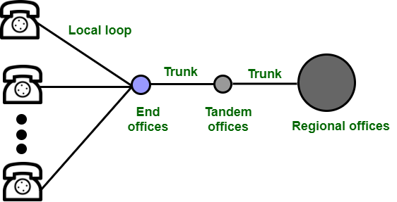

Graphs and their understanding
Why we learn Graph?
Graphs are used to represent networks. The networks may include paths in a city or telephone network or circuit network.
Graphs are also used in social networks like LinkedIn, Facebook. For example, in Facebook, each person is represented with a vertex(or node). Each node is a structure and contains information like person id, name, gender, number etc.

Slide 10
Graphs and their understanding
Different Types of Graph
Null Graph
Trivial Graph
Undirected Graph
Directed Graph
Connected Graph
Disconnected Graph
Regular Graph
Complete Graph
Cycle Graph
Cyclic Graph
Directed Acyclic Graph

Slide 11
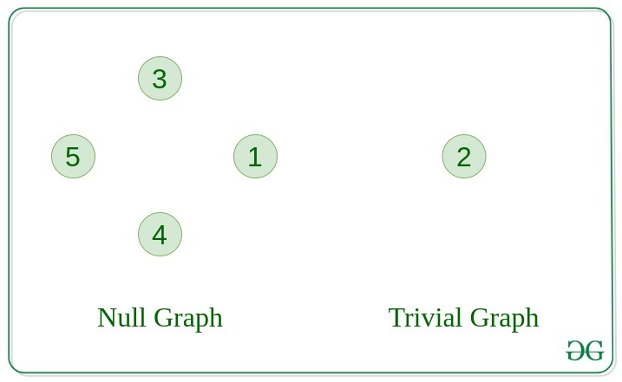
Graphs and their understanding
Null Graph: A graph is known as a null graph if there are no edges in the graph.
Trivial Graph: A graph contains only one vertex and no edge.

Slide 12
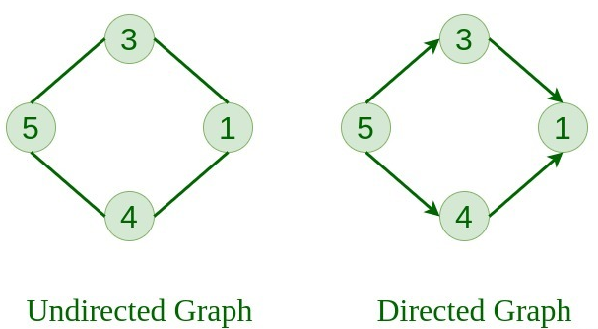
Graphs and their understanding
Undirected Graph: A graph in which edges do not have any direction.
Directed Graph: A graph in which edge has direction..

Slide 13
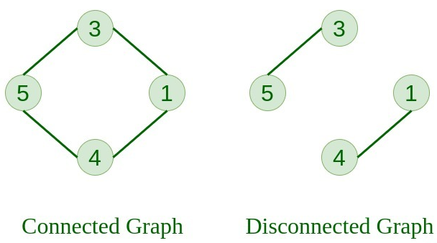
Graphs and their understanding
Connected Graph: The graph in which we can visit from one node to any other node in the graph is known as a connected graph.
Disconnected Graph: The graph in which at least one node is not reachable from any node is known as a disconnected graph.

Slide 14
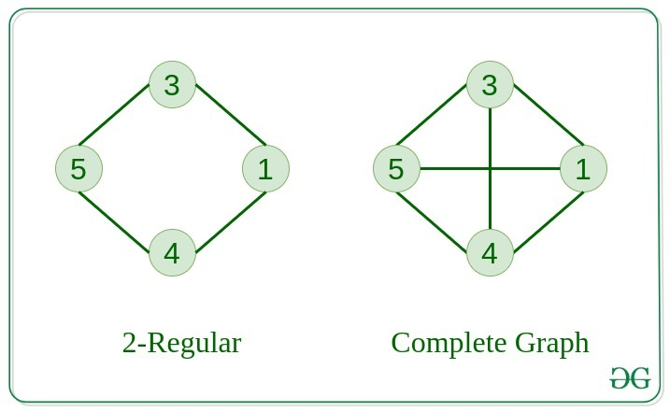
Graphs and their understanding
Regular Graph: The graph in which the degree of every vertex is equal to K is called K regular graph.
Complete Graph: The graph in which from each node there is an edge to each other node.

Slide 15
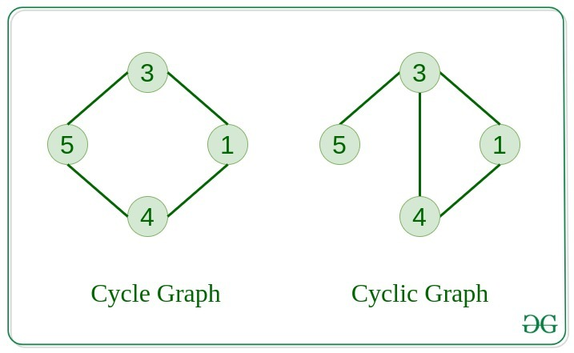
Graphs and their understanding
Cycle Graph: The graph in which the graph is a cycle in itself, the degree of each vertex is 2.
Cyclic Graph: A graph containing at least one cycle is known as a Cyclic graph.

Slide 16
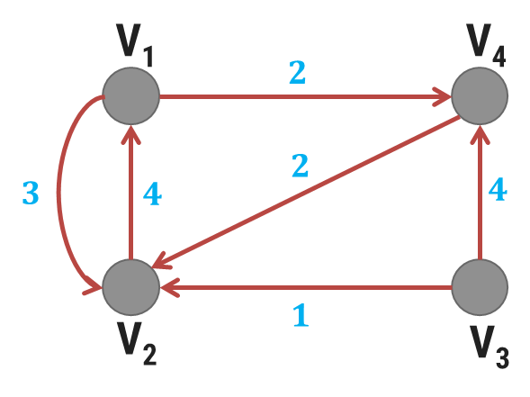
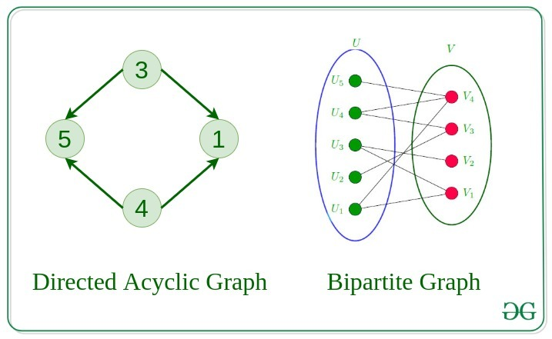
Graphs and their understanding
Directed Acyclic Graph: A Directed Graph that does not contain any cycle.
Weighted Graph: A weighted graph is a graph where the edges have weights.
Weighted Graph

Slide 17
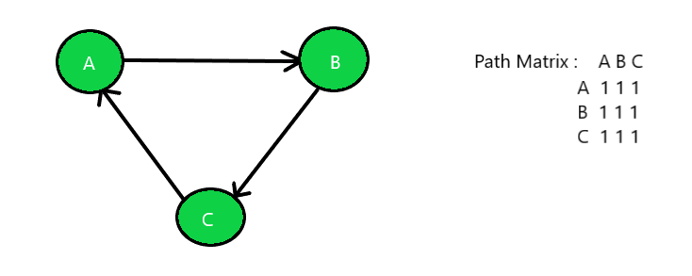
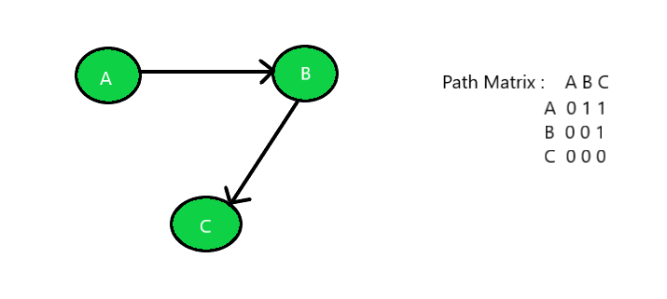
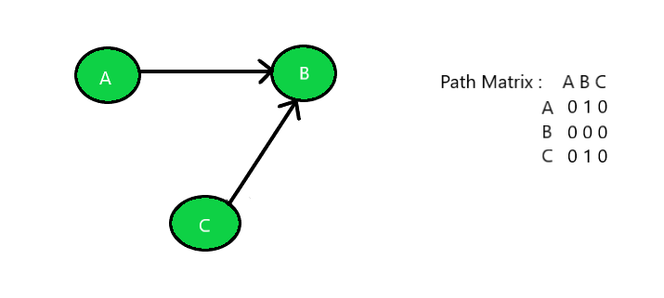
Graphs and their understanding
Strongly Connected or Unilaterally Connected or Weakly Connected
Strongly Connected
Unilaterally Connected
Weakly Connected

Slide 18
Graphs and their understanding
Basic Operations perform on Graph
Insertion of Nodes/Edges in the graph – Insert a node into the graph.
Deletion of Nodes/Edges in the graph – Delete a node from the graph.
Searching on Graphs – Search an entity in the graph.
Traversal of Graphs – Traversing all the nodes in the graph.

Slide 19
Matrix Representation of a Graph
There are two ways to represent a graph:
Adjacency Matrix
Adjacency List

Slide 20
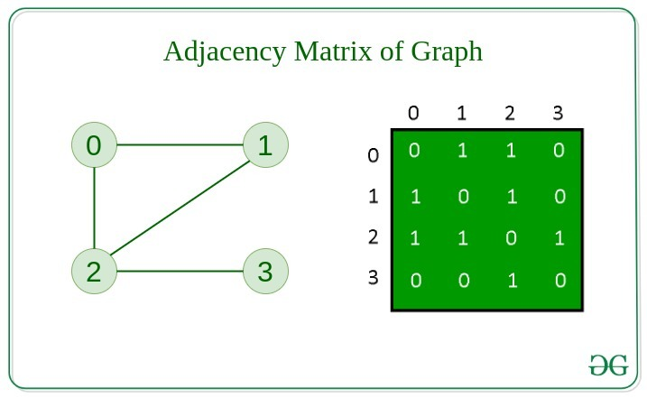
Matrix Representation of a Graph
Adjacency Matrix
In this method, the graph is represent in the form of the 2D matrix where rows and columns denote vertices. Each entry in the matrix represents the weight of the edge between those vertices.

Slide 21
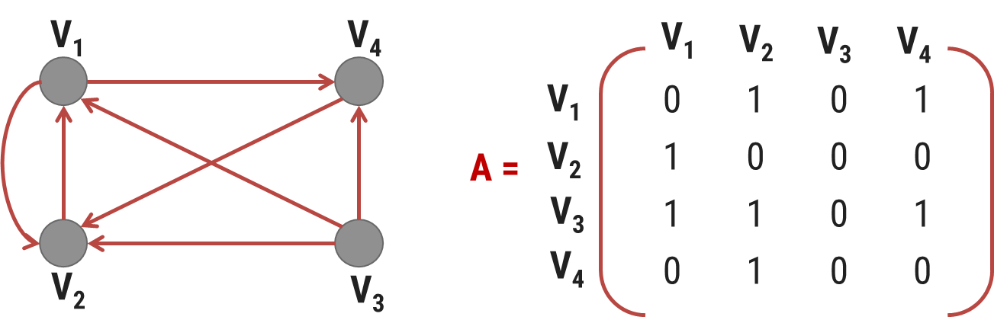
Matrix Representation of a Graph
Adjacency Matrix
In this method, the graph is represent in the form of the 2D matrix where rows and columns denote vertices. Each entry in the matrix represents the weight of the edge between those vertices.

Slide 22
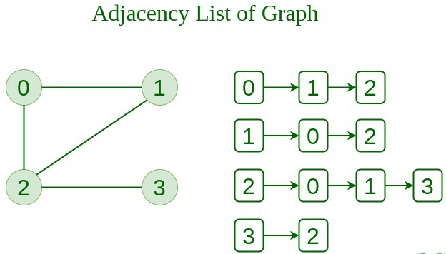
Matrix Representation of a Graph
Adjacency List
This graph is represented as a collection of linked lists.
There is an array of pointer which points to the edges connected to that vertex.

Slide 23
0
Matrix Representation of a Graph
Adjacency List
This graph is represented as a collection of linked lists.
There is an array of pointer which points to the edges connected to that vertex.
4
1
2
3
0
1
2
3
4
1
2
3
4
0
3
0
3
4
0
1
2
4
0
2
3

Slide 24
Depth First Search (DFS)

Slide 25
Depth First Search (DFS) Introduction
Depth first search (DFS) is traversal technique.
A standard DFS implementation puts each vertex of the graph into one of two categories:
Visited
Not Visited
The purpose of the algorithm is to mark each vertex as visited while avoiding cycles.
It is a recursive algorithm to search all the vertices of a tree or a graph.
The depth-first search (DFS) algorithm starts with the initial node of graph G and goes deeper until we find the target node.
Because of the recursive nature, stack data structure can be used to implement the DFS algorithm.

Slide 26
Depth First Search (DFS) Example
Traversal can start from any vertex Vi.
Vi is visited and then all vertices adjacent to Vi are traversed recursively using DFS.
DFS (G, 1) is given by
✓
1
Step 1: Visit (1)
Step 2: DFS (G, 2)
DFS (G, 3)
DFS (G, 4)
DFS (G, 5)
DFS (G, 2):
Step1: Visit(2)
Step 2: DFS (G, 6)
✓
2
5
✓
✓
3
✓
4
DFS (G, 6):
Step1: Visit(6)
Step 2: DFS (G, 3)
DFS (G, 8)
✓
6
✓
7
DFS of given graph starting from node 1 is given by
✓
8
1
2
6
3
8
7
4
5

Slide 27
Procedure: DFS (Vertex V)
This procedure traverse the graph G in DFS manner.
V is a starting vertex to be explored.
Visited[ ] is an array which tells you whether particular vertex is visited or not.
W is a adjacent node of vertex V.
S is a Stack, PUSH and POP are functions to insert and remove from stack respectively.

Slide 28
Procedure: DFS (Vertex V)
1. [Initialize TOP and Visited]
visited[] ← 0
TOP ← -1
2. [Push vertex into stack]
PUSH (V)
3. [Repeat while stack is not Empty]
Repeat Step 3 while stack is not empty
v ← POP()
if visited[v] is 0
then visited [v] ← 1
for all W adjacent to v
if visited [w] is 0
then PUSH (W)
end for
end if

Slide 29
Procedure: DFS (Vertex V)
The DFS algorithm works as follows:
Start by putting any one of the graph's vertices on top of a stack.
Take the top item of the stack and add it to the visited list.
Create a list of that vertex's adjacent nodes. Add the ones which aren't in the visited list to the top of the stack.
Keep repeating steps 2 and 3 until the stack is empty.

Slide 30
Depth First Search (DFS) Example - 1
Let's see how the Depth First Search algorithm works with an example. We use an undirected graph with 5 vertices.
5
1
4
3
Visited
2
5
S

Slide 31
Depth First Search (DFS) Example - 1
We start from vertex 1, the DFS algorithm starts by putting it in the Visited list and putting all its adjacent vertices in the stack.
5
1
4
3
1
2
3
Visited
2
5
4
S

Slide 32
Depth First Search (DFS) Example - 1
Next, we visit the element at the top of stack i.e. 2 and go to its adjacent nodes. Since 1 has already been visited and 3 is already added in stack.
5
1
4
3
1
2
2
3
Visited Nodes
2
5
4
S

Slide 33
Depth First Search (DFS) Example - 1
Next, we visit the element at the top of stack i.e. 3 and go to its adjacent nodes. Since 1 & 2 have already been visited and adjacent vertex 5 push to the stack.
5
1
4
3
1
2
3
5
3
Visited Nodes
2
5
4
S

Slide 34
Depth First Search (DFS) Example - 1
Next, we visit the element at the top of stack i.e. 5 and there is no adjacent nodes. So, vertex 4 is only available in the stack.
5
1
4
3
1
2
3
5
5
Visited Nodes
2
5
4
S

Slide 35
Depth First Search (DFS) Example - 1
Next, we visit the element at the top of stack i.e. 4 and go to its adjacent nodes. Since 1 has already been visited.
5
1
4
3
1
2
3
5
4
Visited Nodes
2
5
4
S

Slide 36
Depth First Search (DFS) Example - 1
Now stack is empty it means all the nodes are visited successfully.
5
1
4
3
1
2
3
5
4
Visited Nodes
2
5
S

Slide 37
Depth First Search (DFS) Examples
✓
A
✓
B
C
✓
M
N
O
✓
D
✓
E
F
✓
G
✓
R
Q
P
H
✓
A
B
D
H
E
C
F
G
M
R
Q
N
O
P
✓
A
✓
✓
B
✓
C
E
A
B
D
C
F
E
✓
D
F
✓

Slide 38
Breadth First Search (BFS)

Slide 39
Breadth First Search (BFS) Introduction
A standard BFS implementation puts each vertex of the graph into one of two categories:
Visited
Not Visited
The purpose of the algorithm is to mark each vertex as visited while avoiding cycles.

Slide 40
Breadth First Search (BFS) Introduction
Breadth First Search is Traversal Techniques.
This methods starts from vertex V₀ .
V₀ is marked as visited. All vertices adjacent to V₀ are visited next.
Let vertices adjacent to V₀ are V₁, V₂, V₂, V_{4.}
V₁, V₂, V₃ and V₄ are marked visited.
All unvisited vertices adjacent to V₁, V₂, V₃, V₄ are visited next.
The method continuous until all vertices are visited.
The algorithm for BFS has to maintain a list of vertices which have been visited but not explored for adjacent vertices.
The vertices which have been visited but not explored for adjacent vertices can be stored in queue.

Slide 41
Breadth First Search (BFS) Example
✓
✓
A
✓
1
✓
2
5
✓
B
✓
C
✓
✓
✓
3
4
✓
D
✓
E
F
✓
G
6
✓
7
✓
8
H
✓
✓
1
|
2
3
4
5
|
6
7
|
8
A
| B C
| D E F G
| H
V₄
V₁
V₀| V₁ V₂ | V₄ V₆ V₃ | V₅
V₂
V₀
V₆
V₃
V₅

Slide 42
Procedure: BFS (Vertex V)
This procedure traverse the graph G in BFS manner.
V is a starting vertex to be explored.
Q is a queue.
visited[ ] is an array which tells you whether particular vertex is visited or not
W is a adjacent node of vertex V.

Slide 43
Procedure: BFS (Vertex V)
1. [Initialize Queue & Visited]
visited[] ← 0
F ← R ← 0
2. [Marks visited of V as 1]
visited[v] ← 1
3. [Add vertex v to Q]
InsertQueue(V)
4. [Repeat while Q is not Empty]
Repeat while Q is not empty
v ← RemoveFromQueue()
For all vertices W adjacent to v
If visited[w] is 0
Then visited[w] ← 1
InsertQueue(w)

Slide 44
Procedure: BFS (Vertex V)
The BFS algorithm works as follows:
Start by putting any one of the graph's vertices at the back of a queue.
Take the front item of the queue and add it to the visited list.
Create a list of that vertex's adjacent nodes. Add the ones which aren't in the visited list to the back of the queue.
Keep repeating steps 2 and 3 until the queue is empty.

Slide 45
Breadth First Search (BFS) Example - 1
Let's see how the Breadth First Search algorithm works with an example. We use an undirected graph with 5 vertices.
5
1
4
3
Visited Nodes
2
5
F
R

Slide 46
Breadth First Search (BFS) Example - 1
We start from vertex 1, the BFS algorithm starts by putting it in the Visited list and putting all its adjacent vertices in the queue.
5
1
4
1
3
Visited Nodes
2
5
2
3
4
F
R
F
R
R
R

Slide 47
Breadth First Search (BFS) Example - 1
Next, we visit the first element of the queue i.e. 2 and go to its adjacent nodes. Since 1 has already been visited and 3 is already added in queue.
5
1
4
1
2
3
Visited Nodes
2
5
2
3
4
F
F
R

Slide 48
Breadth First Search (BFS) Example - 1
Next, we visit the first element of the queue i.e. 3 and go to its adjacent nodes. Since 1 & 2 have already been visited and adjacent vertex 5 insert to the queue.
5
1
4
1
2
3
3
Visited Nodes
2
5
3
4
5
F
F
R
R

Slide 49
Breadth First Search (BFS) Example - 1
Next, we visit the first element of the queue i.e. 4 and go to its adjacent nodes. Since 1 has already been visited.
5
1
4
1
2
3
4
3
Visited Nodes
2
5
4
5
F
F
R

Slide 50
Breadth First Search (BFS) Example - 1
Next, we visit the last element of the queue i.e. 5 and go to its adjacent nodes. Since 3 has already been visited.
1
4
1
2
3
4
5
3
Visited Nodes
2
5
5
F
R
F
R

Slide 51
Breadth First Search (BFS) Example - 1
Now queue is empty it means all the nodes are visited successfully.
1
4
1
2
3
4
5
3
Visited Nodes
2
5
F
R

Slide 52
BFS Examples
A
B
C
M
N
O
D
E
F
G
R
Q
P
M
N
Q
R
|
O
P
H
|
A
|
B
C
|
D
E
F
G
|
H
A
A
0
1
B
C
E
B
E
A
|
B
C
D
E
5
2
D
F
4
3
C
D
A
B
|
|
C
D
E
F
0
|
1
5
4
|
2
3

Slide 53

Thank
You

